Slide 1
NEO4J CYPHER TUTORIAL WITH PYTHON
Create Multiple Nodes In Neo4j Graph From Csv Input Using Apoc Procedure & Python
Tutorial 97

Slide 2
Use case
Create Multiple Nodes In Neo4j Graph From Csv Input Using Apoc Procedure & Python

Slide 3
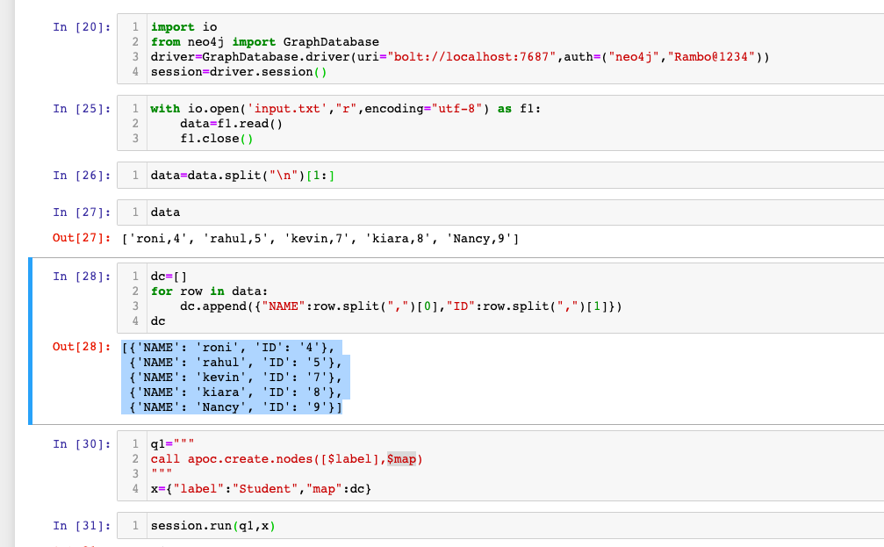
Create Multiple Nodes In Neo4j Graph From Csv Input Using Apoc Procedure & Python
Code written in python ide

Slide 4
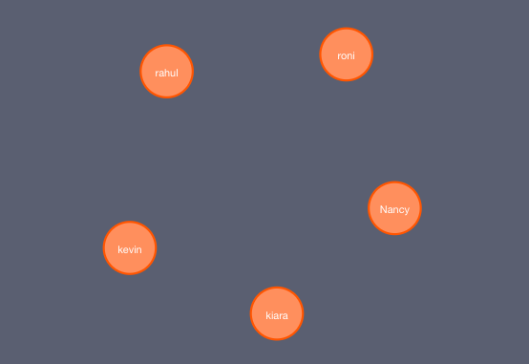
output
From python ide

